Slide 1
Module 1:
Foundations of
Machine Learning and Data Science
for Security
Machine Learning for Cybersecurity
January 1, 2020

Slide 2

What is machine learning?
spam filter
automatic discovery of rules from history

Slide 3
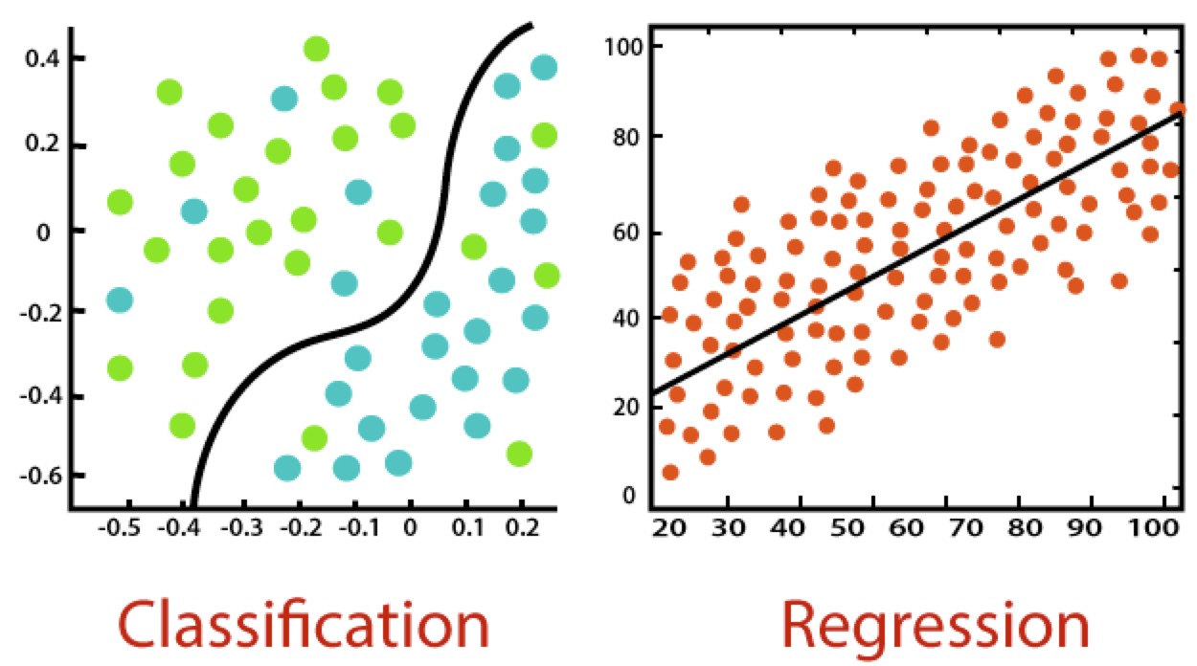
Supervised machine learning
classification vs regression
learning rules from training data

Slide 4
Statistical machine learning
Data
Domain set
Label set
A joint probability distribution on training data
Model
A prediction function
Measure of success
A loss function

Slide 5
Measurement of success
Given the prediction function and the loss function, the loss of an example is
Training error/ empirical error of
Generalization error/ risk/ true error

Slide 6
Learning objective
Given a collection of observations, and a model class, the goal of learning is to determine an estimator that best matches the observation (i.e., with the minimal error wrt a certain loss function)

Slide 7
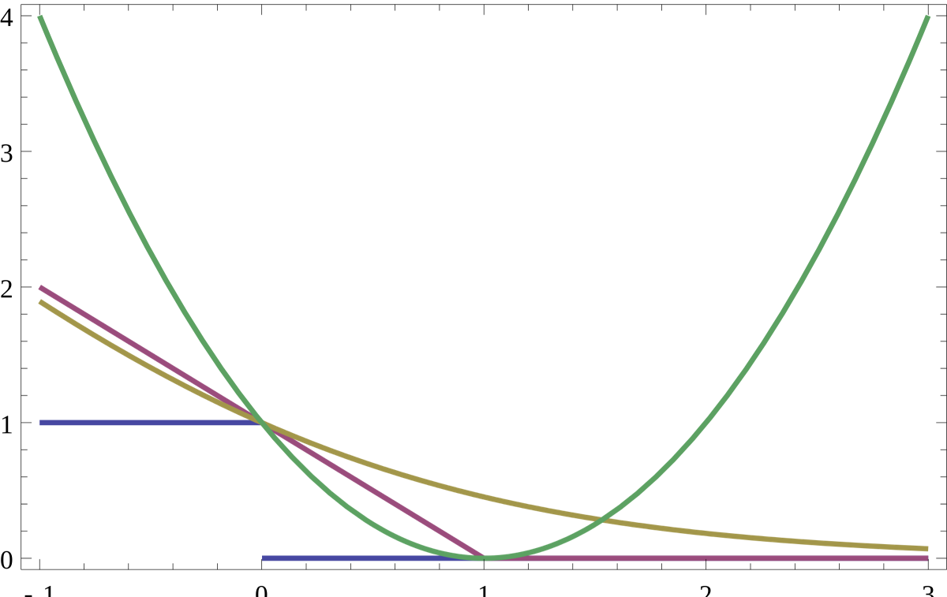
Example of a loss function (classification loss)
0-1 loss:
misclassification error
hinge loss :
penalize correct predictions when not confident
log loss:
always wants more “margin”
square loss
magnify penalties if is large

Slide 8
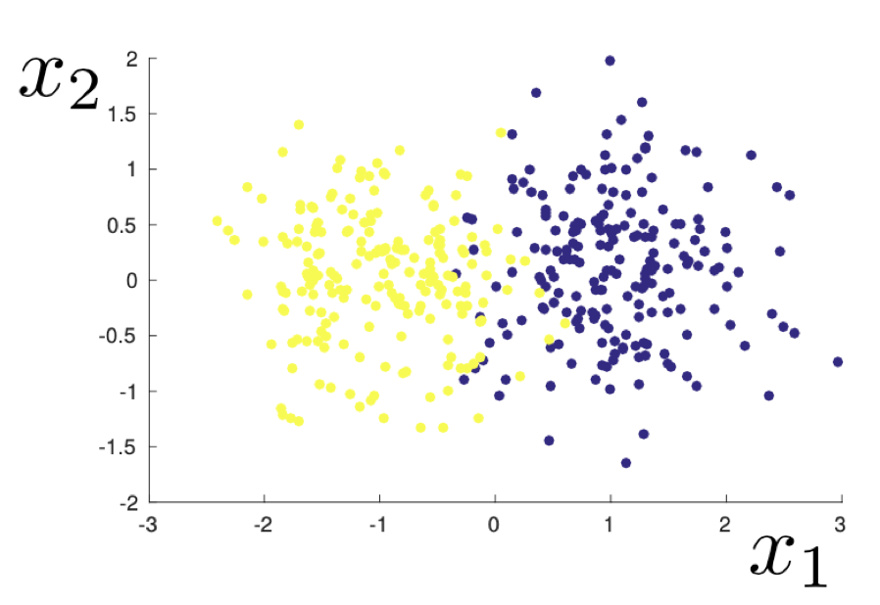
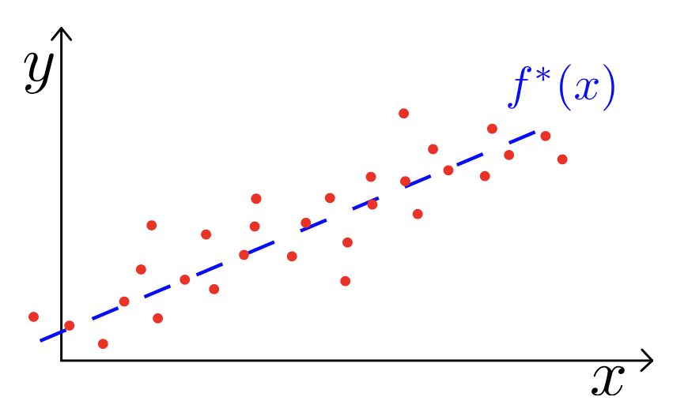
Stability, overfitting, and regularization
2D example of a dataset sampled from a mixed Gaussian distribution
Fixed unknown linear function

Slide 9
Supervised Learning

Slide 10
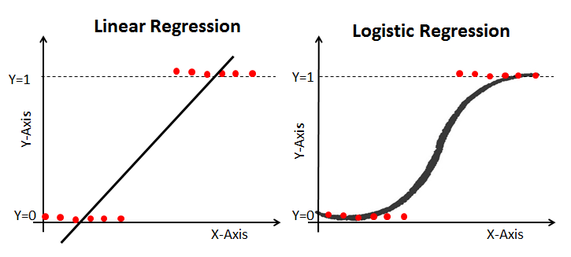
Logistic regression
Use regression model for the class probability

Slide 11
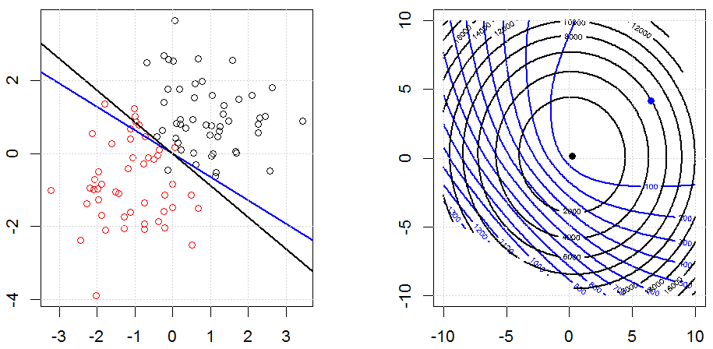
Demo
Notes:
Application – replace with cybersecurity application (spam filtering)

Slide 12
Failure cases for logistic regression
What will logistic regression predict for data point x?

Slide 13
Discriminative vs generative classification
Discriminative models aim to estimate conditional distribution P(y | x)
Generative models aim to estimate joint distribution P(y,x)
Can derive conditional from joint distribution, but not vice versa.

Slide 14
Naïve Bayes classifier (NB)
Model class label as generated from categorical variable
Model features as conditionally independent given label
given class label, each feature is generated independently of the other features
need to specify feature distribution P (X[i] | Y )

Slide 15
Gaussian Naïve Bayes classifier (Gaussian NB)
Model class label as generated from categorical variable
Model features as conditionally independent given label
given class label, each feature is generated independently of the other features
need to specify feature distribution P (X[i] | Y )

Slide 16
Decision rules for binary classification

Slide 17
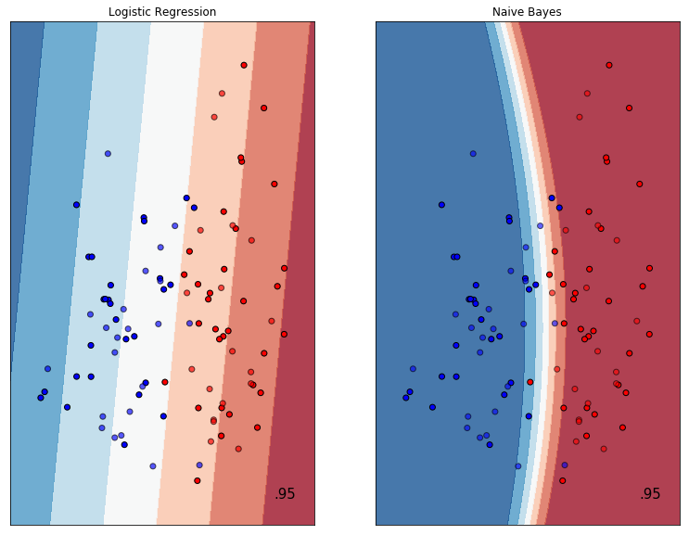
Demo: Demo: Gaussian NB vs LR (linear)

Slide 18
Demo: Gaussian NB vs LR (multi-class)

Slide 19
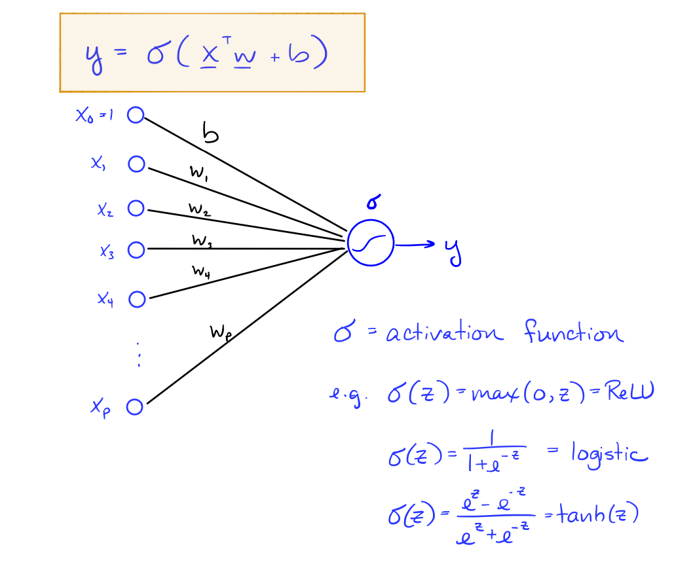
Neural networks

Slide 20
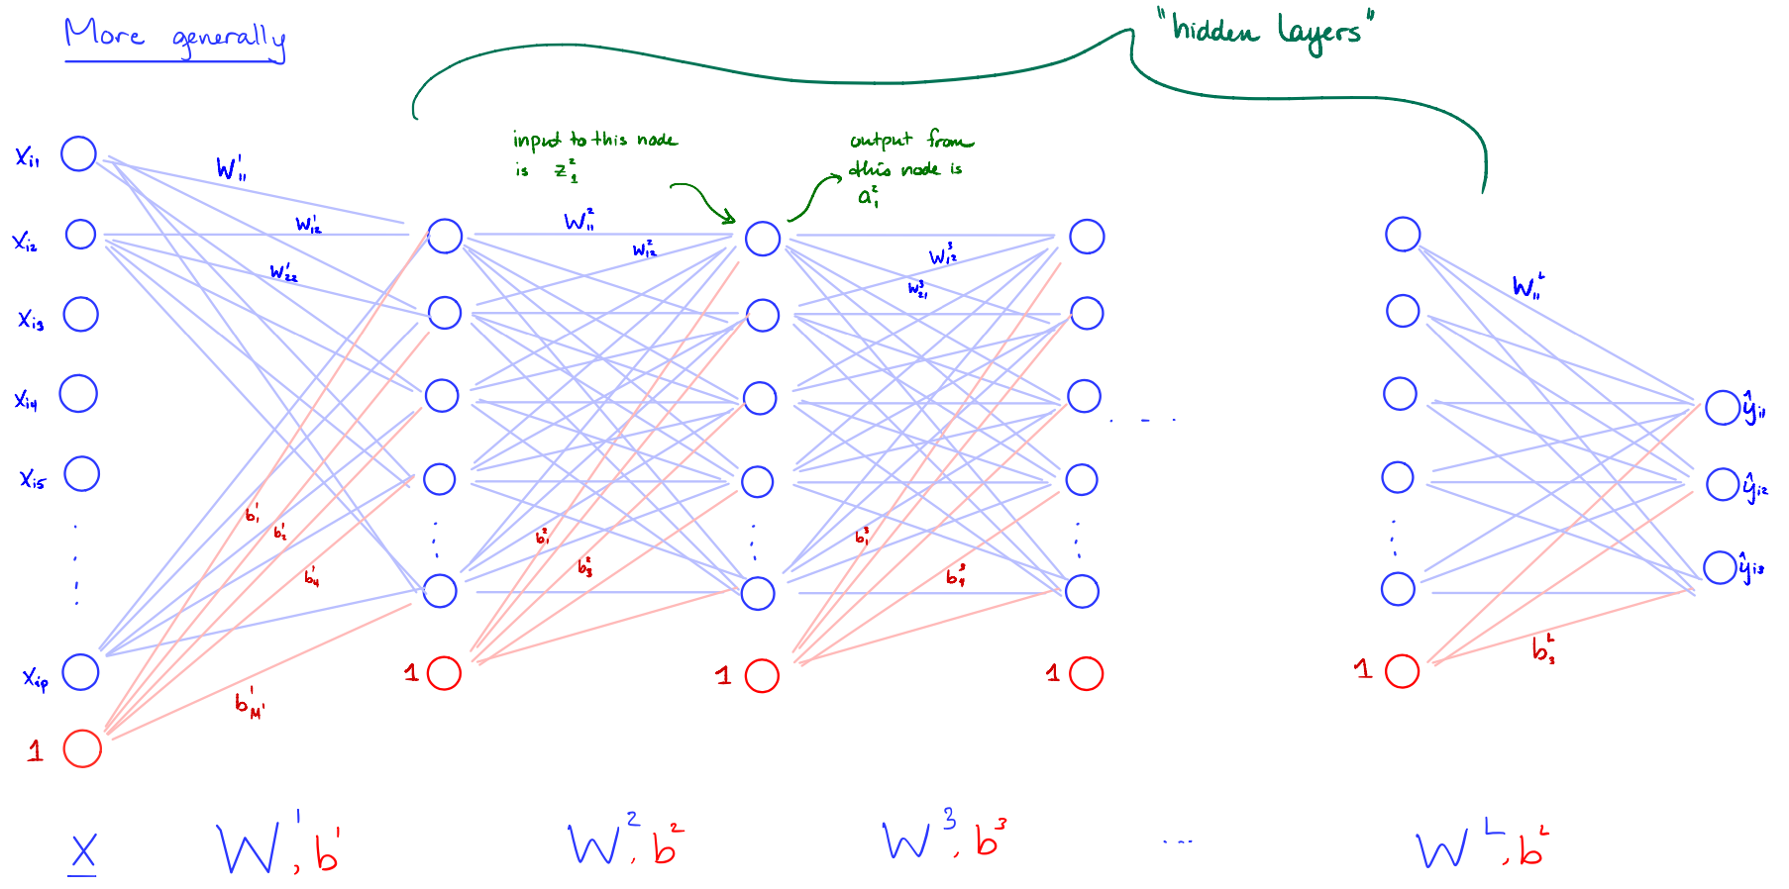
Neural networks

Slide 21
Demo

Slide 22
Unsupervised Models

Slide 23
Dimensionality reduction

Slide 24
Principled component analysis

Slide 25
Clustering

Slide 26
K-means algorithms

Slide 27
Gaussian mixture models

Slide 28
Exercise

